Slide 1

Force multiplier for data science: Introduction to H2O
Hank Roark
@hankroark
hank@h2o.ai

Slide 2
DEMONSTRATION

Slide 3
WHO AMI I
Lead, Customer Data Science @ H2O.ai
John Deere: Research, Software Product Development, High Tech Ventures
Lots of time dealing with data off of machines, equipment, satellites, weather, radar, hand sampled, and on.
Geospatial, temporal / time series data almost all from sensors.
Previously at startups and consulting (Red Sky Interactive, Nuforia, NetExplorer, Perot Systems, a few of my own)
Engineering & Management MIT Physics Georgia Tech
hank@h2oai.com @hankroark https://www.linkedin.com/in/hankroark

Slide 4
What IS H2O?
Math Platform
Open source in-memory prediction engine
Parallelized and distributed algorithms making the most use out of multithreaded systems
API
Easy to use and adopt
Written in Java – perfect for Java Programmers
Big Data
More data? Or better models? BOTH
Use all of your data – model without down sampling
GLM, Random Forest, GBM, Deep Learning, etc.
REST API (JSON) – drives H2O from Browser UI, R, Python, Tableau
Run a simple GLM or a more complex GBM to find the best fit for the data
More Data + Better Models = Better Predictions

Slide 5
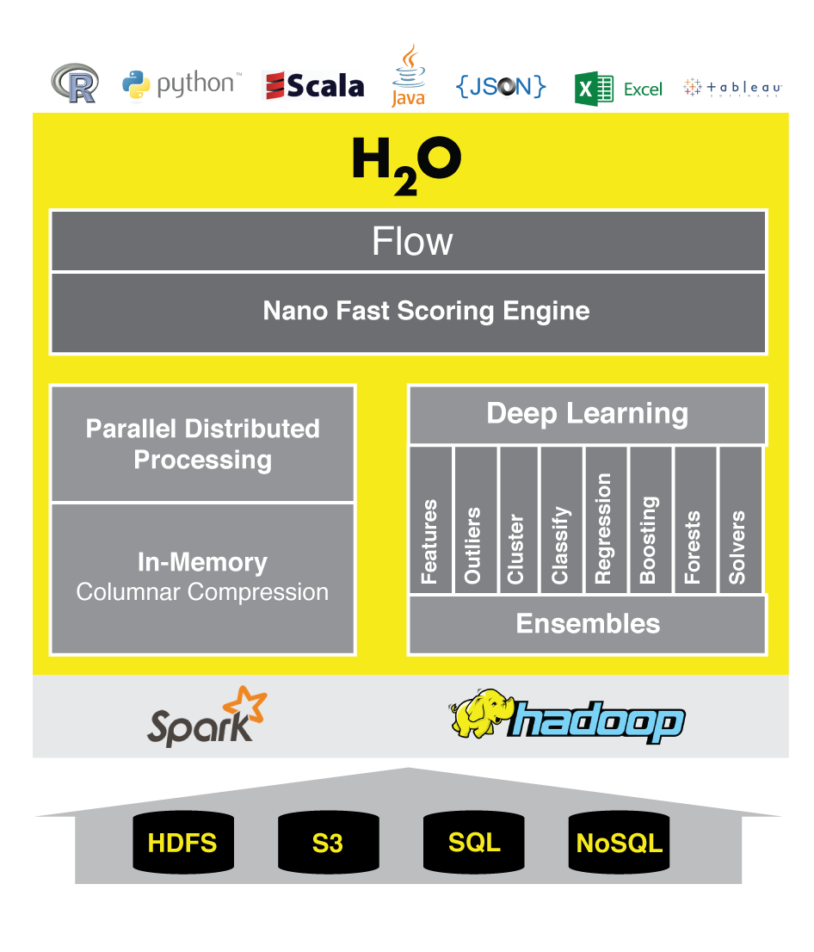
Accuracy with speed and scale

Slide 6



Accuracy with speed and scale
HDFS
Fast Modeling Engine
In-Memory
Feature Engineering
Deep Learning
Matrix Factorization
S3
Clustering
Map Reduce/Fork Join
PCA, GLM, Cox
Classification
Regression
Munging
Random Forest / GBM Ensembles
Columnar Compression
SQL
Streaming
Nano Fast Java Scoring Engines
NoSQL

Slide 7
H2O SOFTWARE STACK
Customer Algorithm
JavaScript
R
Python
Excel/Tableau
Flow
Network
Rapids Expression Evaluation Engine
Scala / Java
Customer Algorithm
GLM
GBM
RF
Deep Learning
K-Means
PCA
Parse
In-H2O Prediction Engine
Customer Algorithm
Fluid Vector Frame
Job
Distributed K/V Store
MRTask
Non-blocking Hash Map
Fork/Join
Spark
Hadoop
Standalone H2O

Slide 8
Hadoop (and YARN)
You can launch H2O directly on Hadoop:
$ hadoop jar h2odriver.jar … -nodes 3 –mapperXmx 50g
H2O uses Hadoop MapReduce to get CPU and Memory on the cluster, not to manage work
H2O mappers stay at 0% progress forever
Until you shut down the H2O job yourself
All mappers (3 in this case) must be running at the same time
The mappers communicate with each other
Form an H2O cluster on-the-spot within your Hadoop environment
No Hadoop reducers(!)
Special YARN memory settings for large mappers
yarn.nodemanager.resource.memory-mb
yarn.scheduler.maximum-allocation-mb
CPU resources controlled via –nthreads h2o command line argument

Slide 9
H2O on YARN Deployment
Hadoop Gateway Node
Hadoop Cluster
hadoop jar h2odriver.jar …
YARN RM
YARN Worker Nodes
YARN Node
Managers (NM)
NM
NM
NM
NM
NM
NM
H2O Mappers
(YARN Containers)
H₂O
H₂O
H₂O
HDFS
Data Nodes
HDFS

Slide 10
Now You Have an H2O Cluster
Hadoop Gateway Node
Hadoop Cluster
hadoop jar h2odriver.jar …
YARN RM
YARN Worker Nodes
YARN Node
Managers (NM)
NM
NM
NM
H2O Mappers
(YARN Containers)
H₂O
H₂O
H₂O
HDFS
Data Nodes
HDFS

Slide 11
Read Data from HDFS Once
Hadoop Gateway Node
Hadoop Cluster
hadoop jar h2odriver.jar …
YARN RM
YARN Worker Nodes
YARN Node
Managers (NM)
NM
NM
NM
H2O Mappers
(YARN Containers)
H₂O
H₂O
H₂O
HDFS
Data Nodes
HDFS

Slide 12
Build Models in-Memory
Hadoop Gateway Node
Hadoop Cluster
hadoop jar h2odriver.jar …
YARN RM
YARN Worker Nodes
YARN Node
Managers (NM)
NM
NM
NM
H2O Mappers
(YARN Containers)
H₂O
H₂O
H₂O
Notes:
H2O MapReduce is not Hadoop MapReduce
For more details, go visit cliff in his Hacker corner.

Slide 13

PYTHON AND R OBJECTS ARE PROXIES FOR BIG DATA
STEP 1
h2o_df = h2o.import_file(“hdfs://path/to/data.csv”)
Python user

Slide 14
PYTHON AND R OBJECTS ARE PROXIES FOR BIG DATA
STEP 2
2.3
Initiate distributed ingest
H2O Cluster
2.2
Python
H₂O
HTTP REST API request to H₂O
has HDFS path
H₂O
h2o.import_file()
H₂O
2.1
Python function call
2.4
Request data from HDFS
HDFS
data.csv
Notes:
Data never goes into or through Python
Python tells H2O what to do
Python has a pointer to the big data that lives in H2O
Operations on the Python object are intercepted using operator overleading and forwarded to H2O via the REST API
H2OFrame object in Python is a proxy for the big data in H2O
Python: df= h2o.import_file(“hdfs://path/to/data.csv”)
h2o_df is an H2OFrame object in R

Slide 15
PYTHON AND R OBJECTS ARE PROXIES FOR BIG DATA
STEP 3
3.2
Distributed H₂O
Frame in DKV
H2O Cluster
3.3
Python
H₂O
h2o_df
Return pointer to data in REST API JSON Response
H₂O
H₂O
Frame
Cluster IP
Cluster Port
Pointer to Data
H₂O
3.4
h2o_df object created in Python
3.1
HDFS provides data
HDFS
data.csv

Slide 16
PYTHON SCRIPT STARTING H2O GLM
TCP/IP
HTTP
HTTP
REST/JSON
REST/JSON
Legend
POST /3/ModelBuilders/glm
/3/ModelBuilders/glm endpoint
Network layer
Job
REST layer
glm_estimator.train()
GLM algorithm
H2O - algos
GLM tasks
H2O - core
Python script
Fork/Join framework
K/V store framework
User process
Standard Python process
H2O process
H2O process

Slide 17
PYTHON SCRIPT STARTING H2O GLM
TCP/IP
HTTP
HTTP
REST/JSON
REST/JSON
Legend
GET /3/Models/model_id
/3/Models endpoint
Network layer
REST layer
glm_estimator.show()
H2O - algos
H2O - core
Python script
Fork/Join framework
K/V store framework
User process
Standard Python process
H2O process
H2O process

Slide 18


H₂O on Storm
Modeling workflow
Real-time Stream
H₂O
(Spout)
Emit POJO Model
Real-time data
(Bolt)
H₂O
Scoring
POJO
Data
Source
(e.g. HDFS)
Predictions

Slide 19
H₂O – The Killer-App for Spark
H2O Sparkling Water
MLlib
H2O
SQL
In-Memory | Big Data, Columnar
ML | 100x faster Algos
R | CRAN, API, fast engine
API | Spark API, Java MM
Community | Devs, Data Science
H2ORDD
HDFS=DATA
H₂O.ai Machine Intelligence

Slide 20
Spark (and Sparkling Water)
H2O runs as an application on a Spark cluster using spark-submit
Standard Spark 1.3+
Includes H2O on Spark on YARN
H2O and Spark nodes share a JVM process
H2ORDD facilitates easy data sharing between Spark (e.g. Spark SQL, MLlib) and H2O (e.g. Deep Learning)
Scala & PySpark support

Slide 21
Sparkling Water Application Life Cycle
Sparkling Water Cluster
Spark
Worker
JVM
Spark
Executor
JVM
H₂O
(3)
(4)
(2)
Spark
Master
JVM
Spark
Worker
JVM
Spark
Executor
JVM
Sparkling App
jar file
H₂O
spark-submit
(1)
Spark
Worker
JVM
Spark
Executor
JVM
H₂O
Notes:
Striking similarity to hadoop
(1) User submits App to Spark cluster Master node
(2) App distributed to Spark cluster Worker nodes
(3) Spark Executor JVMs start for App
(4) H₂O instance starts within each Executor JVM
(5) App’s Scala/Python main program runs
Once scala program drives both your H2O and Spark workloads

Slide 22
Sparkling Water Data Distribution
Sparkling Water Cluster
Data
Source
(e.g. HDFS)
Spark Executor JVM
H₂O
(1)
Spark
RDD
H₂O
RDD
(2)
H₂O
(3)
Spark Executor JVM
H₂O
Spark Executor JVM
Notes:
Use Spark SQL to read data into a Spark RDD
Convert Spark RDD to H₂O RDD; H₂O RDD is column-based and highly compressed
(Not shown) Run modeling and prediction workflows with H₂O
(3) Convert H₂O RDD (e.g. predictions) back to Spark RDD

Slide 23
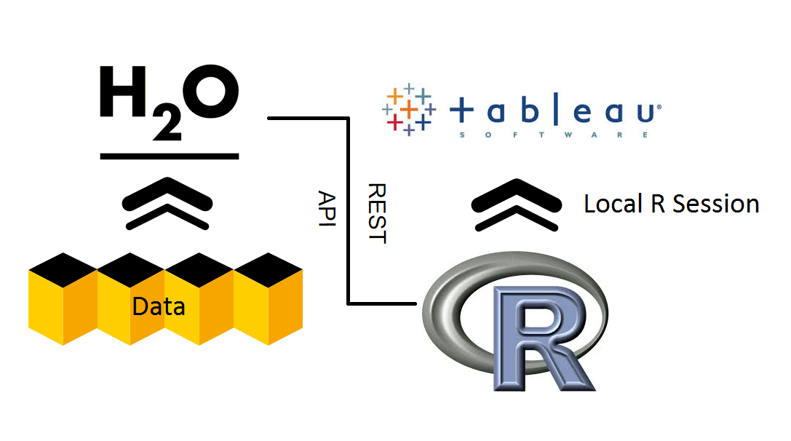
OPEN FOR INTEGRATION
H₂O.ai Machine Intelligence

Slide 24
RESOURCES
Download and go: http://www.h2o.ai/download
Documentation: http://docs.h2o.ai/
Booklets, Datasheet: http://www.h2o.ai/resources/
Github: http://github.com/h2oai/
Training: http://learn.h2o.ai/

Slide 25
GET INVOLVED
CONTRIBUTE: http://github.com/h2oai
COMMIT: careers@h2o.ai
(Algorithm engineers, software engineers, customer data scientists, solutions architects, …)

Slide 26
THANK YOU

